Slide 1
How to Prevent Ransomware
Scott Lynch, CCNP-S, GCDA, GNFA, GCIH, GDSA

Slide 2

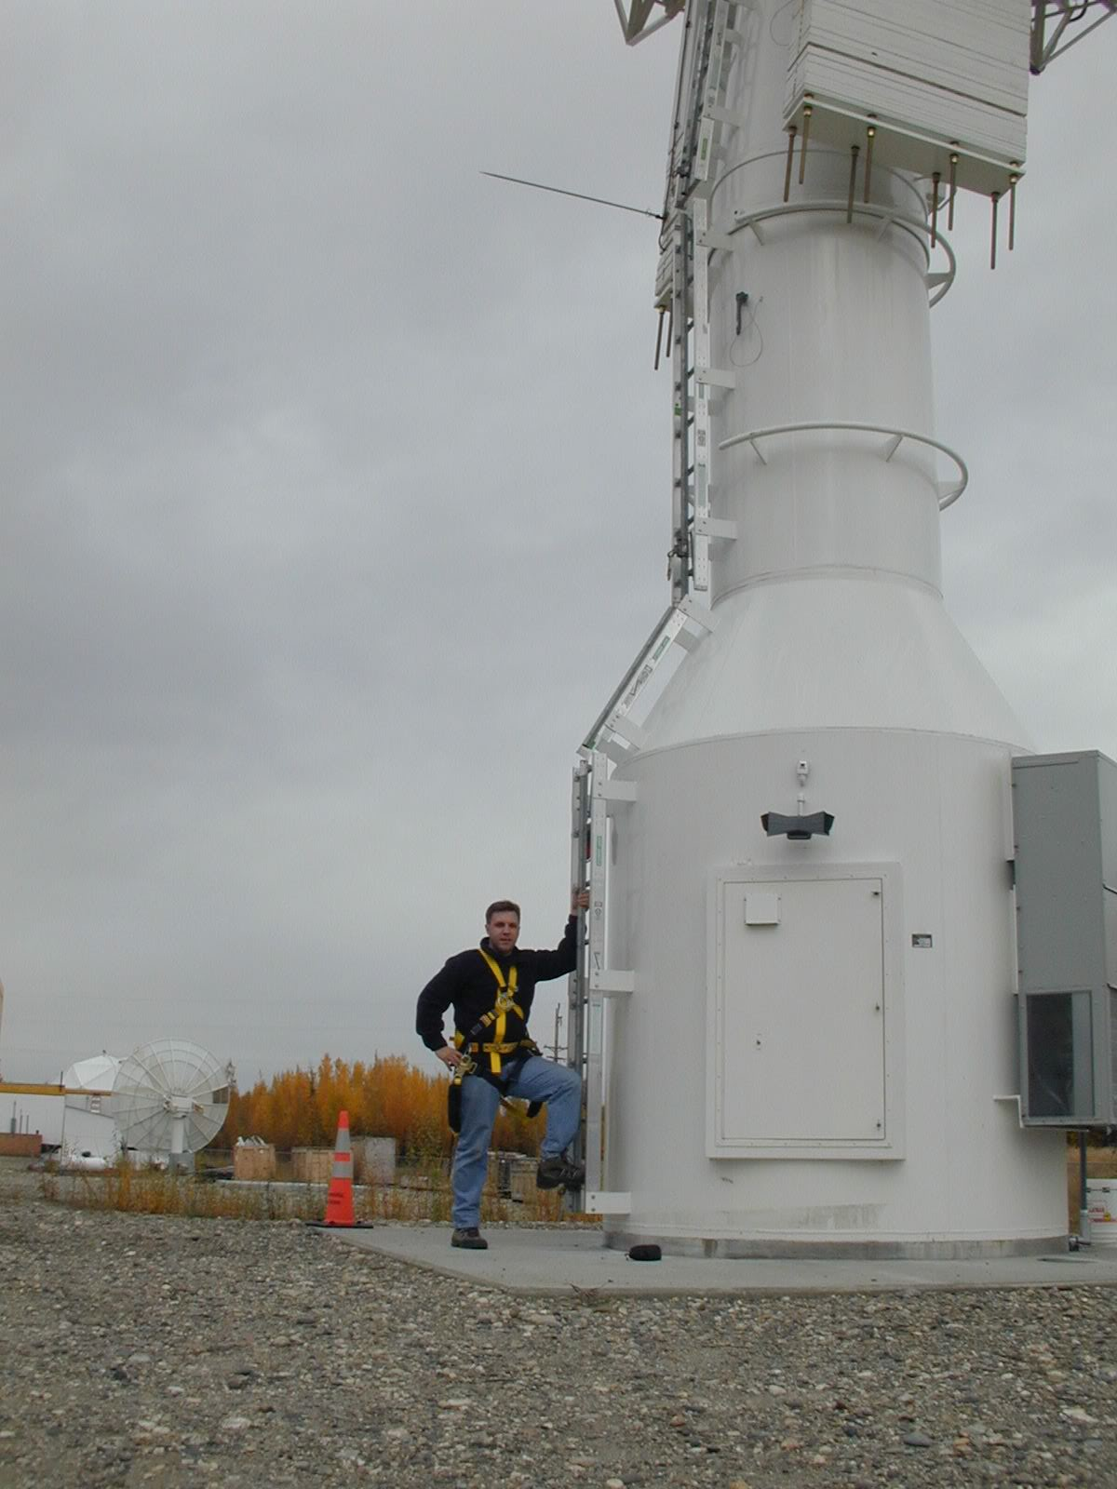


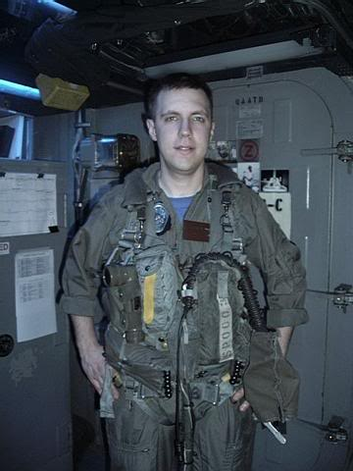



Who am I
Scott Lynch
Lynch@packetengineer.com
Twitter @PacketEngineer
SANS Instructor SEC555: SIEM with Tactical Analytics https://www.sans.org/profiles/scott-lynch/
Cisco Instructor, BCCC CCNA
Manager Security Operations, SSC Space
US Navy Veteran, Electronic Warfare/Information Warfare
CCNP-S, GCDA, GDSA, GCIH, GNFA

Slide 3
Human Operated Ransomware (HORA)
Source: Microsoft

Slide 4
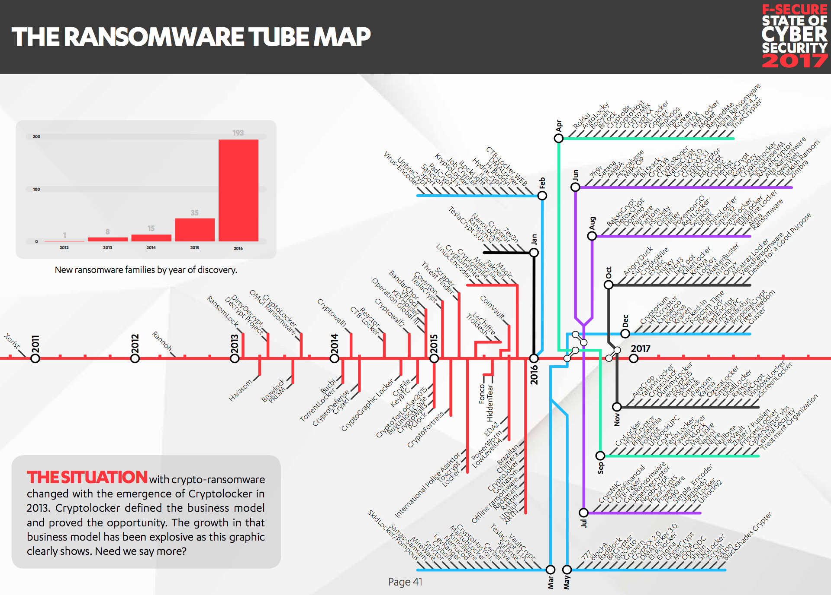
Example Attacks
Merk
WannaCry
Honda
WannaCry
Colonial Pipeline
DarkSide Ransomware Gang
Mersk
NotPetya
JBS
REvil / Sodinokibi Group
Champaign-Urbana Public Health District
NetWalker
Source: F-Secure

Slide 5

Quick Wins
User Training
Risk Analysis
Application Whitelisting
Backups and DR/BC
Multifactor Authentication (MFA)
Patch Management & Vulnerability Scanning
Email Security
Attachment Filtering/DMARC/DKIM/SPF
Host Based Firewalls
Least Privilege
Testing

Slide 6

User Training
Users are first line of defense
Human Intrusion Detection and Anomaly Systems
User Awareness Training
HHS
SANS
Develop a program
Follow-up Annually or as new threats develop

Slide 7
Risk Analysis
What is your current risk?
Ransomware Self-Assessment Tool
How are you tracking and documenting
US CERT - CRR Supplemental Resource Guide
CDC.Gov - Risk Management Log Template
CIS Top 20 – Heard of it?

Slide 8

Application Whitelisting
NIST - Guide to Application Whitelisting
Microsoft AppLocker
Applocker Overview
A/V and EDR
Windows Firewall

Slide 9
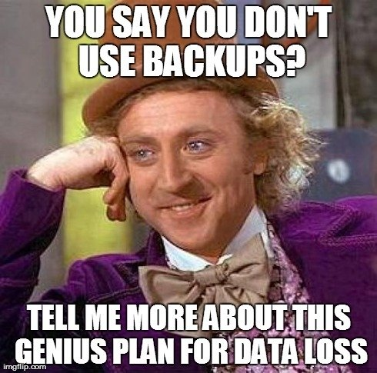
Backups, DR and BC
You need to have a plan
Not a backup plan! A Preemptive plan
Do you have a Business Continuity Plan (BCP)
Ready.Gov BCP
Document, Implement, Test and Repeat
IBM Planning a backup and recovery strategy Checklist
Don’t assume anything!!
Who is responsible for ensuring your backups are working? You are!
Tabletop exercises are great for identifying failure points where backups can save you
9 Steps to an Effective Tabletop BCP Test

Slide 10
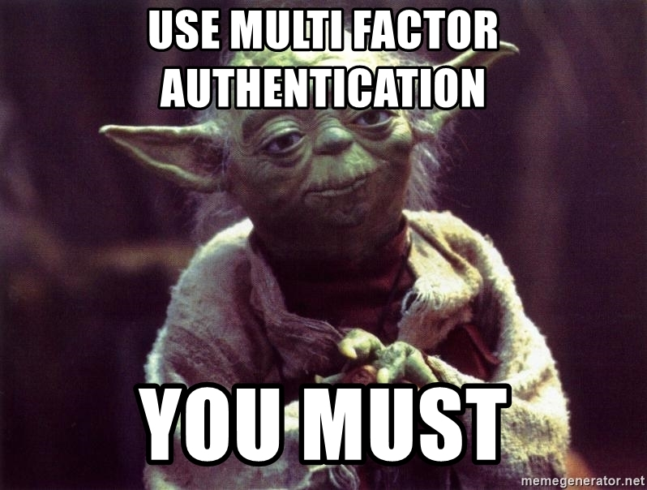
Multifactor Authentication (MFA)
Use MFA/2FA for external validation
VPN
Email
Cloud Services
Password Managers
Try and avoid SMS Based systems
YubiKey Even Better
Yubico
Whenever possible require a second authentication with a physical/app token
CISA.GOV Supplementing Passwords

Slide 11

Patch Management & Vulnerability Scanning
Attack surface reduction
Don’t make it easy for an attacker
Keep an eye on current vulnerabilities and patches needed to mitigate
Cisco Talos Intel Blog
FireEye Threat Research Blog
Palo Alto Unit 42 Threat Research
Develop a patch management strategy
A Practical Methodology for Implementing a Patch management Process
Creating a Patch and Vulnerability Management Program

Slide 12
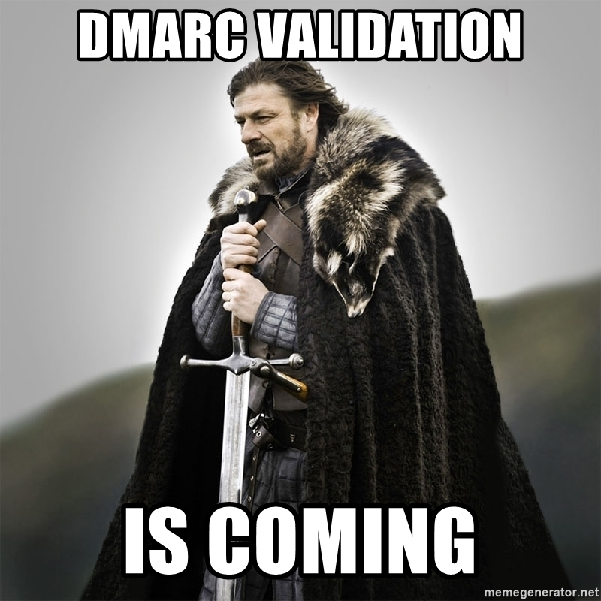
Email Security and DNSSec
Attachment Filtering
Domain-based Message Authentication, Reporting & Conformance (DMARC)
DomainKeys Identified Mail (DKIM)
Sender Policy Framework (SPF)
DNS Security (DNSSec)

Slide 13
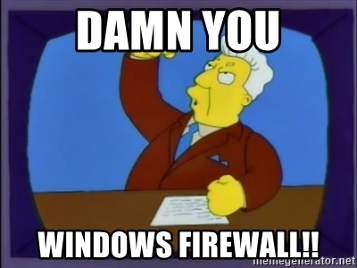
Endpoint Firewalls
Useful for mitigating lateral movement by attacker
Block SMB
Log Failed Inbound Connections
Great opportunity for detection
Enable logging for IR
Restricting SMB-based lateral movement in a Windows environment
Bonus Active Directory Best Practices to Frustrate Attackers: Webcast & Write-up

Slide 14
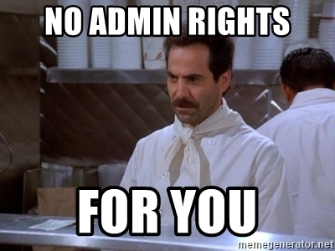
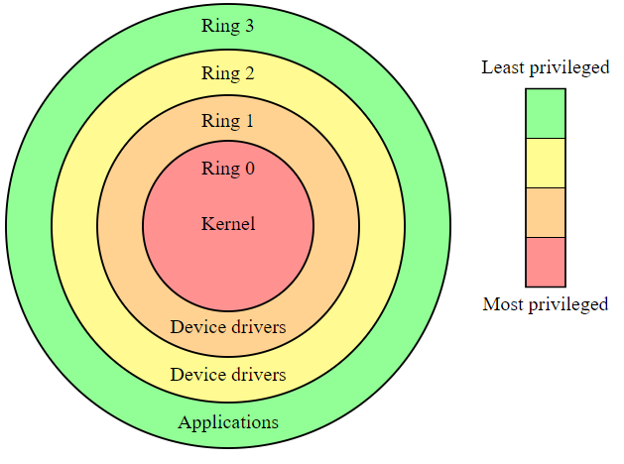
Principle of Least Privilege (PoLP)
Limit the number of rights a user is granted
Only what is necessary to do their job
https://us-cert.cisa.gov/bsi/articles/knowledge/principles/least-privilege
“Every program and every privileged user of the system should operate using the least amount of privilege necessary to complete the job.”
— Jerome Saltzer, Communications of the ACM

Slide 15
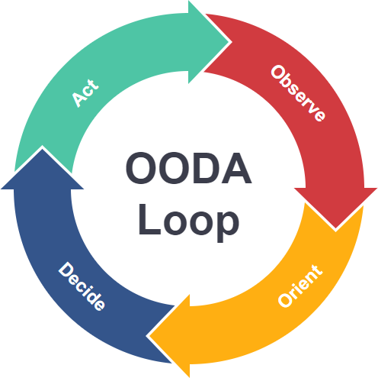
Testing
Testing of mitigation and detection
Red Team vs Purple Team
The Difference Between Red, Blue, and Purple Teams
A Blue Team's Perspective on Red Team Hack Tools
Unicorn Evangelism: The Case for Purple Teaming | Kent Icker & Jordan Drysdale | The Roundup

Slide 16
Useful Links and Material
Links of further interest
Windows Firewall
Containment Strategies
Principle of Least Privilege - PoLP
Microsoft LAPS
User Training
Data Analysis for Cyber Security 101: Detecting Lateral Movement
Human-operated ransomware attacks: A preventable disaster
Videos of Interest
Eric Conrad - Build it Once, Build it Right: Architecting for Detection
Ryan Chapman - LOCKED OUT! Detecting, Preventing, & Reacting to Human Operated Ransomware
SANS Threat Analysis Rundown - Ransomware with guest speaker Ryan Chapman
Ransomware Books
Ransomware Revealed: A Beginner’s Guide to Protecting and Recovering from Ransomware Attacks 1st ed. Edition ISBN-13: 978-1484242544
Preventing Ransomware: Understand, prevent, and remediate ransomware attacks ISBN-13: 978-1788620604
Preventing Digital Extortion: Mitigate ransomware, DDoS, and other cyber-extortion attacks ISBN-13: 978-1787120365
Ransomware Protection Playbook 1st Edition ISBN-13: 978-1119849124

Slide 17
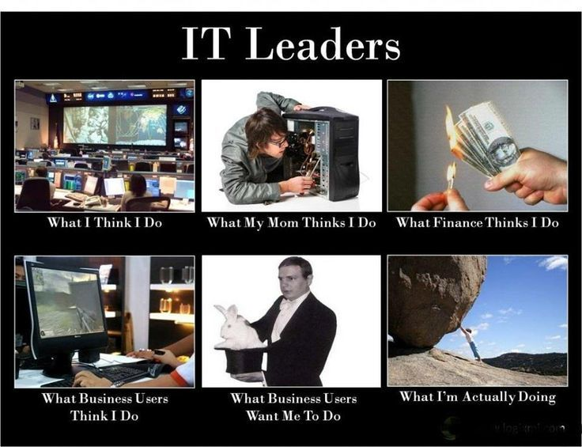
People to follow for more awesomeness
Eric Conrad @eric_conrad
Justin Henderson @SecurityMapper
Sean Metcalf @PyroTek3
Ryan Chapman @rj_chap
Katie Nickels @likethecoins
Brian Krebs @briankrebs
Vitali Kremez @VK_Intel
Florian Roth @cyb3rops

Slide 18
Questions

